Slide 1
BFX AT-100 RMA 25PCS RMA & 1PCS DOA FA REPORT
Prepare by: PE – JUSTIN
Date: 2024/12/04

Slide 2
FA TEAM
Fii | ALT OTT
Team Leader: PE Leader: Jack Han TE Leader: Mark QA: Toney Tu Team Members: TE: Allan ME: Wen-tai PE: Michael Ruan/ Justin QA: Ken/ Rachel PM: Roisy | Team Leader: QA: SH Son Team Members:

Slide 3
Problem Description
Issue Description (5W1H)
When | 2024-Dec-04
Who | SH Son
Where | ALT customer side
What | ALT customer return 25pcs RMA no boot issue
Why | - Burned *10pcs~40% + 6pcs U801_RTL8211F-CG location + 3pcs R825, R826 location + 1pcs U303 location - Measure: + L304_P3V3 short GND *6pcs~24% + L801_REG_OUT short GND*4pcs~16% - Normally: *5pcs~20%
How many | 25pcs / 388pcs ~ 6.4% RMA can’t Boot up

Slide 4
History Data Checking - T Level
No.# | MAC | T_SN | TEST STATION
 |  |  | SMTLOADING | TURNPCB | INSP | PCB_STOCKIN
1 | 2C9811A619C2 | Y0N0ZKK | 08/06/2024 08:57 PM | 09/06/2024 04:39 PM | 09/06/2024 11:28 PM | 10/06/2024 01:11 AM
2 | 2C9811A67F85 | Y0O1GVM | 12/06/2024 10:37 AM | 12/06/2024 09:04 PM | 14/06/2024 05:39 AM | 15/06/2024 05:28 PM
3 | 2C9811A6A23C | Y0O32AE | 17/06/2024 10:12 PM | 18/06/2024 05:48 AM | 18/06/2024 08:40 PM | 19/06/2024 02:41 PM
4 | 2C9811A6DB22 | Y0O3396 | 17/06/2024 10:53 PM | 18/06/2024 12:17 PM | 19/06/2024 02:34 PM | 20/06/2024 08:00 AM
5 | 2C9811A7885E | Y0R0MJE | 03/07/2024 02:50 PM | 04/07/2024 10:23 AM | 04/07/2024 12:29 PM | 05/07/2024 09:35 AM
6 | 2C9811A79E1C | Y0R0Z56 | 04/07/2024 10:16 PM | 05/07/2024 05:12 PM | 05/07/2024 08:17 PM | 09/07/2024 12:50 PM
7 | 2C9811A8398A | Y0W18XQ | 09/08/2024 02:30 AM | 10/08/2024 01:19 AM | 10/08/2024 01:58 AM | 10/08/2024 05:46 AM
8 | 2C9811A49925 | YZM16PM | 05/03/2024 10:41 PM | 08/03/2024 05:42 PM | 10/03/2024 12:41 AM | 10/03/2024 03:31 PM
9 | A83B76FFEF77 | YZM1CXJ | 08/03/2024 02:18 PM | 09/03/2024 01:17 AM | 09/03/2024 04:09 PM | 10/03/2024 03:57 AM
10 | 2C9811A48723 | YZO00SV | 10/03/2024 01:55 PM | 10/03/2024 07:25 PM | 11/03/2024 01:12 AM | 11/03/2024 08:07 PM
11 | 2C9811A4A2DE | YZO03XR | 10/03/2024 08:36 PM | 11/03/2024 07:14 AM | 11/03/2024 01:00 PM | 12/03/2024 11:00 PM
12 | 2C9811A4F07D | YZQ08E0 | 02/04/2024 08:46 PM | 04/04/2024 11:46 PM | 05/04/2024 01:08 PM | 05/04/2024 10:04 PM
13 | 2C9811A50B16 | YZQ0C2C | 03/04/2024 11:06 AM | 04/04/2024 04:53 AM | 04/04/2024 12:28 PM | 04/04/2024 03:31 PM
14 | 2C9811A53429 | YZQ0MEE | 05/04/2024 05:01 AM | 05/04/2024 11:36 AM | 06/04/2024 08:35 AM | 07/04/2024 08:11 AM
15 | 2C9811A5537A | YZR0PXO | 06/04/2024 10:39 AM | 06/04/2024 09:56 PM | 07/04/2024 09:12 PM | 08/04/2024 05:32 PM
16 | 2C9811A548CE | YZR0UBB | 07/04/2024 12:43 AM | 07/04/2024 06:45 AM | 08/04/2024 07:34 AM | 09/04/2024 03:19 AM
17 | 2C9811A571C3 | YZR0XSO | 07/04/2024 12:30 PM | 07/04/2024 10:39 PM | 08/04/2024 06:57 PM | 09/04/2024 12:54 PM
18 | 2C9811A60788 | YZV00LD | 02/05/2024 11:29 AM | 07/05/2024 04:21 AM | 07/05/2024 06:52 AM | 07/05/2024 08:46 AM
19 | 2C9811A58E01 | YZV04TB | 03/05/2024 07:58 PM | 04/05/2024 01:10 AM | 04/05/2024 03:44 AM | 04/05/2024 07:58 AM
20 | 2C9811A58E55 | YZV04UV | 03/05/2024 07:59 PM | 04/05/2024 01:22 AM | 04/05/2024 01:03 PM | 04/05/2024 04:44 PM
21 | 2C9811A57A5B | YZV07GN | 07/05/2024 01:52 AM | 07/05/2024 03:22 PM | 08/05/2024 08:11 AM | 08/05/2024 01:50 PM
22 | 2C9811A62306 | YZV08VA | 07/05/2024 08:24 PM | 08/05/2024 12:39 AM | 08/05/2024 04:08 AM | 08/05/2024 05:37 AM
23 | 2C9811A57D39 | YZV090Q | 07/05/2024 08:47 PM | 07/05/2024 10:54 PM | 08/05/2024 11:03 AM | 08/05/2024 05:24 PM
24 | 2C9811A677E8 | YZW0HFW | 08/05/2024 01:56 AM | 08/05/2024 04:54 PM | 09/05/2024 12:06 AM | 09/05/2024 08:15 AM
25 | 2C9811A57C12 | YZV090Q | 07/05/2024 08:32 PM | 07/05/2024 11:41 PM | 08/05/2024 03:20 PM | 09/05/2024 12:41 AM
26 | 2C9811A5C5E6 | YZW0S31 | 09/05/2024 08:14 PM | 10/05/2024 06:23 PM | 11/05/2024 08:21 AM | 12/05/2024 09:55 AM
Summary:
- This unit has PASSED normally SMT

Slide 5
History Data Checking - DOT Level
No.# | MAC | TEST STATION
 |  | UK | FT | FT1 | RC | RC1 | RC2 | SHIPPING DATE
1 | 2C9811A619C2 | 10/06/2024 10:44 AM | 10/06/2024 10:49 AM | 10/06/2024 10:58 AM | 11/06/2024 02:15 AM | 11/06/2024 02:28 AM | 11/06/2024 02:50 AM | 6/13/2024
2 | 2C9811A67F85 | 16/06/2024 03:09 PM | 16/06/2024 03:16 PM | 16/06/2024 03:28 PM | 16/06/2024 03:41 PM | 16/06/2024 03:52 PM | 16/06/2024 08:03 PM | 6/19/2024
3 | 2C9811A6A23C | 20/06/2024 09:56 AM | 20/06/2024 10:05 AM | 20/06/2024 10:13 AM | 20/06/2024 10:19 AM | 20/06/2024 10:30 AM | 20/06/2024 10:34 AM | 6/24/2024
4 | 2C9811A6DB22 | 21/06/2024 08:27 AM | 21/06/2024 08:35 AM | 21/06/2024 08:41 AM | 21/06/2024 08:46 AM | 21/06/2024 08:57 AM | 21/06/2024 09:02 AM | 6/24/2024
5 | 2C9811A7885E | 07/07/2024 05:53 AM | 07/07/2024 06:01 AM | 07/07/2024 06:07 AM | 07/07/2024 06:11 AM | 07/07/2024 07:47 AM | 07/07/2024 08:49 AM | 7/12/2024
6 | 2C9811A79E1C | 10/07/2024 02:22 AM | 10/07/2024 02:28 AM | 10/07/2024 02:37 AM | 10/07/2024 02:58 AM | 10/07/2024 03:19 AM | 10/07/2024 03:25 AM | 7/15/2024
7 | 2C9811A8398A | 10/08/2024 10:45 AM | 10/08/2024 10:49 AM | 10/08/2024 10:56 AM | 10/08/2024 11:02 AM | 10/08/2024 12:17 PM | 10/08/2024 12:21 PM | 8/13/2024
8 | 2C9811A49925 | 11/03/2024 01:40 AM | 11/03/2024 01:46 AM | 11/03/2024 01:59 AM | 11/03/2024 01:45 PM | 11/03/2024 01:59 PM | 11/03/2024 02:04 PM | 3/14/2024
9 | A83B76FFEF77 | 10/03/2024 09:57 AM | 10/03/2024 10:04 AM | 10/03/2024 10:53 AM | 10/03/2024 10:59 AM | 10/03/2024 11:12 AM | 10/03/2024 12:40 PM | 3/11/2024
10 | 2C9811A48723 | 12/03/2024 05:17 AM | 12/03/2024 05:25 AM | 12/03/2024 05:49 AM | 12/03/2024 05:55 AM | 12/03/2024 07:36 AM | 12/03/2024 07:41 AM | 3/14/2024
11 | 2C9811A4A2DE | 13/03/2024 07:36 AM | 13/03/2024 07:41 AM | 13/03/2024 07:53 AM | 13/03/2024 07:57 AM | 13/03/2024 08:12 AM | 13/03/2024 11:07 AM | 3/14/2024
12 | 2C9811A4F07D | 06/04/2024 04:39 AM | 06/04/2024 04:46 AM | 06/04/2024 05:15 AM | 06/04/2024 06:01 AM | 06/04/2024 07:39 AM | 06/04/2024 07:44 AM | 4/11/2024
13 | 2C9811A50B16 | 05/04/2024 12:17 AM | 05/04/2024 12:21 AM | 05/04/2024 12:26 AM | 05/04/2024 12:29 AM | 05/04/2024 12:44 AM | 05/04/2024 12:48 AM | 4/8/2024
14 | 2C9811A53429 | 07/04/2024 04:58 PM | 07/04/2024 05:03 PM | 07/04/2024 05:30 PM | 07/04/2024 05:33 PM | 07/04/2024 05:43 PM | 07/04/2024 05:47 PM | 4/11/2024
15 | 2C9811A5537A | 08/04/2024 10:31 PM | 08/04/2024 10:38 PM | 09/04/2024 12:02 AM | 09/04/2024 12:07 AM | 09/04/2024 12:21 AM | 09/04/2024 04:58 PM | 4/12/2024
16 | 2C9811A548CE | 09/04/2024 09:24 AM | 09/04/2024 09:30 AM | 09/04/2024 09:52 AM | 09/04/2024 09:57 AM | 09/04/2024 10:09 AM | 09/04/2024 10:14 AM | 4/12/2024
17 | 2C9811A571C3 | 09/04/2024 08:19 PM | 09/04/2024 08:26 PM | 09/04/2024 08:32 PM | 09/04/2024 08:38 PM | 09/04/2024 08:50 PM | 09/04/2024 08:56 PM | 4/12/2024
18 | 2C9811A60788 | 17/05/2024 09:18 AM | 17/05/2024 09:24 AM | 17/05/2024 09:34 AM | 17/05/2024 09:42 AM | 17/05/2024 09:54 AM | 17/05/2024 10:01 AM | 5/20/2024
19 | 2C9811A58E01 | 11/05/2024 09:55 AM | 11/05/2024 10:00 AM | 11/05/2024 10:11 AM | 11/05/2024 10:17 AM | 11/05/2024 10:31 AM | 11/05/2024 10:37 AM | 5/13/2024
20 | 2C9811A58E55 | 11/05/2024 09:46 AM | 11/05/2024 09:50 AM | 11/05/2024 09:58 AM | 11/05/2024 10:01 AM | 11/05/2024 10:12 AM | 11/05/2024 10:19 AM | 5/13/2024
21 | 2C9811A57A5B | 10/05/2024 03:50 AM | 10/05/2024 06:21 PM | 10/05/2024 07:31 PM | 10/05/2024 07:42 PM | 10/05/2024 08:02 PM | 10/05/2024 10:28 PM | 5/13/2024
22 | 2C9811A62306 | 09/06/2024 02:25 PM | 09/06/2024 02:27 PM | 09/06/2024 02:30 PM | 09/06/2024 02:33 PM | 09/06/2024 02:45 PM | 09/06/2024 09:03 PM | 6/13/2024
23 | 2C9811A57D39 | 09/05/2024 09:59 PM | 09/05/2024 10:04 PM | 09/05/2024 10:13 PM | 09/05/2024 10:29 PM | 09/05/2024 10:42 PM | 09/05/2024 10:47 PM | 5/13/2024
24 | 2C9811A677E8 | 08/06/2024 10:01 AM | 08/06/2024 10:08 AM | 08/06/2024 10:13 AM | 08/06/2024 10:30 AM | 08/06/2024 10:55 AM | 08/06/2024 09:11 PM | 6/13/2024
25 | 2C9811A57C12 | 09/05/2024 11:02 PM | 10/05/2024 12:11 AM | 10/05/2024 12:25 AM | 10/05/2024 12:35 AM | 10/05/2024 12:46 AM | 10/05/2024 12:51 AM | 5/13/2024
26 | 2C9811A5C5E6 | 14/05/2024 10:22 AM | 14/05/2024 10:28 AM | 14/05/2024 10:38 AM | 14/05/2024 10:47 AM | 14/05/2024 10:58 AM | 14/05/2024 11:03 AM | 5/16/2024
Summary:
- This unit has PASSED normally FATP

Slide 6
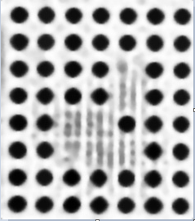

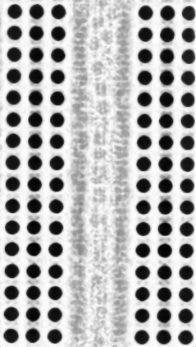
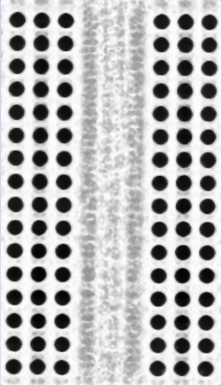
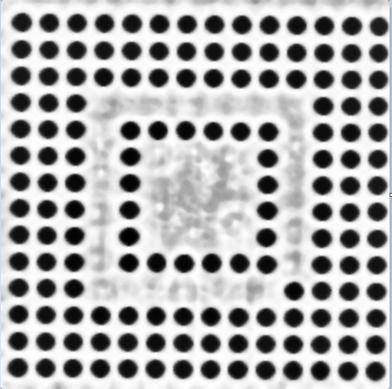

X-ray Checking
X-ray 26 pcs no find out abnormal
 | U1001 | U1(CPU) | U503 | U504 | U505 | U506
X-ray sample of 26 pcs
 | U602 |  | FIL1410 |  | FIL1402
Summary:
- X-ray all 26pcs no find out abnormal

Slide 7
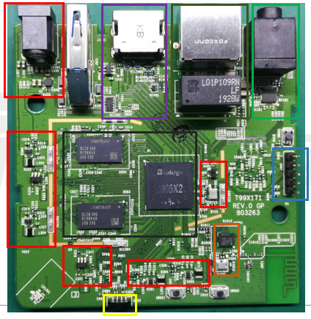
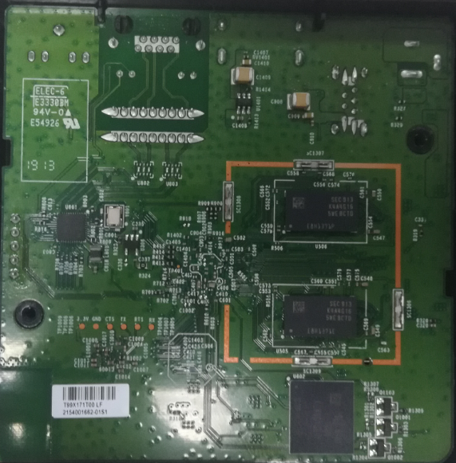
Block Division
Power supply (5V)/U308
USB
HDMI
Ethernet
AV
SYSTEM
PHY
(3.3V/1.0V)/U801
HDMI Power
(3.3V)U1401
DDR 1.2V/2.5V
U505/U506
CPU RESET
(3.3V)/U401
Power (1.2V)/U304
Console
eMMC (1.2V)/U602
Power (3.3V)/U305
CHIP_BT U1001
eMMC_VDDQ (1.2V)/U303
VDDCPU
(0.8V)/U301
LED Control
Q1001 Q1002 Q1103
IR (3.3V)/U402
VDD_EE (0.8V)/U302
TOP
BOT

Slide 8
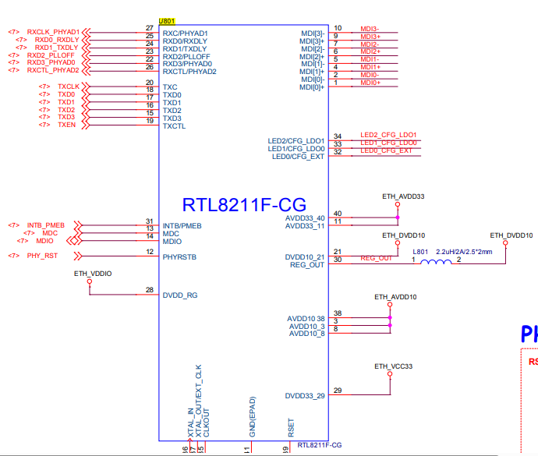
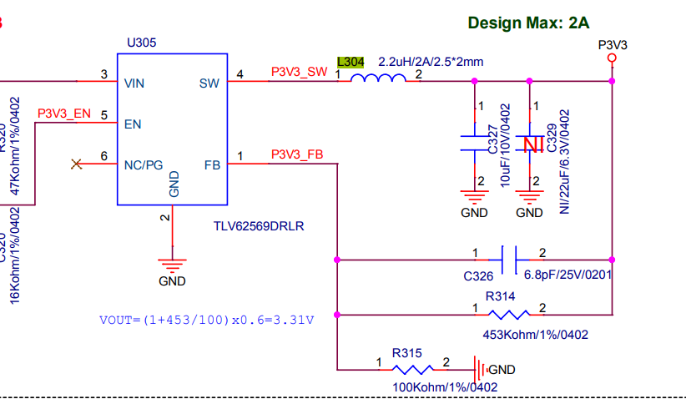
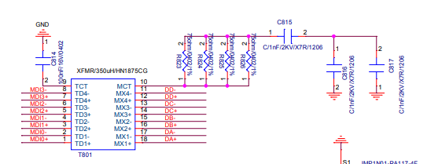
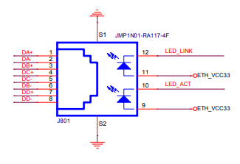
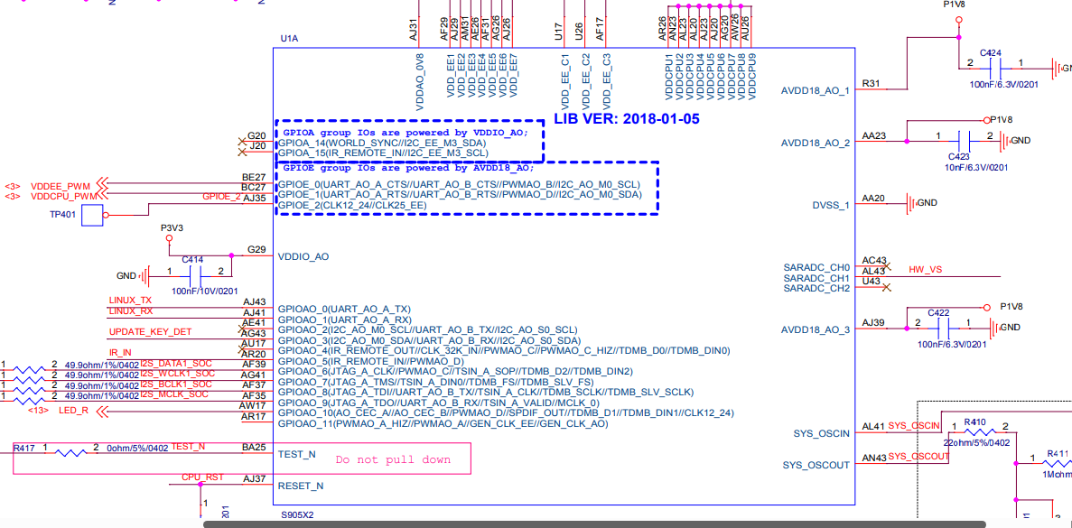
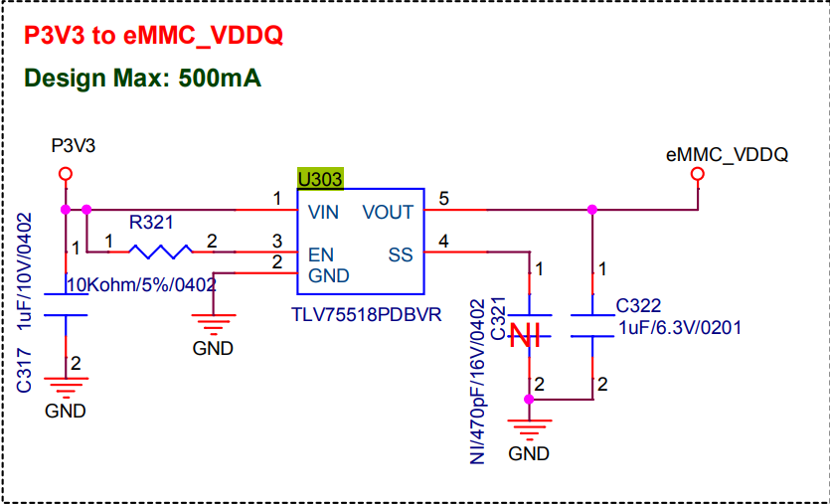
Block Schematic division
L304
U801_RTL8211F-CG
R825, R826
L801
U1_S905X2-B
NOTE
U303
Ethernet block
System block
eMMC block

Slide 9

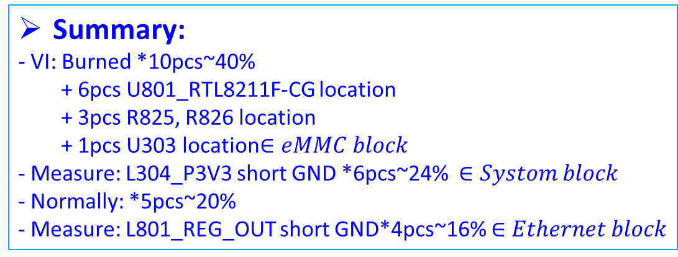
Double check fail symptom
OBA
100% fail
VI
15pcs no find out abnormal
Baking
Re-test OBA
11pcs fail boot up
A
10pcs burned
Suspect scrap
5pcs can boot
FATP
A
Measure impendent
6pcs L304 short
Summary:
- VI: Burned *10pcs~40%
+ 6pcs U801_RTL8211F-CG location
+ 3pcs R825, R826 location
+ 1pcs U303 location$∈eMMC block$
- Measure: L304_P3V3 short GND *6pcs~24% $∈Systom block$
- Normally: *5pcs~20%
- Measure: L801_REG_OUT short GND*4pcs~16% $∈Ethernet block$
4pcs L801 short
$$Ethernet block$$

Slide 10
Top block fail
Sorting 25pcs result:
Summary: have 5 top issue:
- Top 1: Ethernet block fail~52%
- Top 2: System block~24%
- Top 3: No boot~20%
- Top 4: eMMC block fail~4%

Slide 11
Top 1: Ethernet block fail analysis.

Slide 12
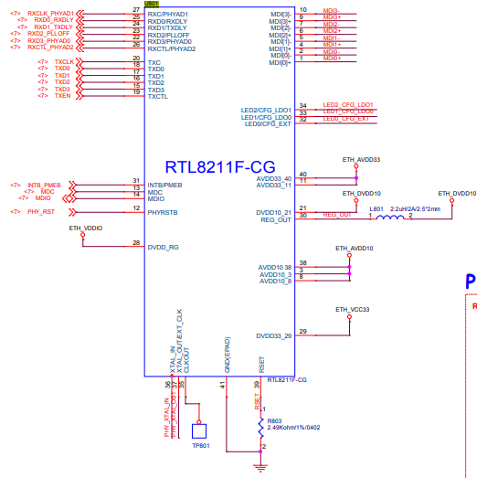

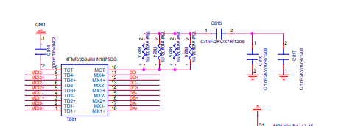
Burn abnormal analysis
Check VI 25 Boards find out 9pcs was burnt at Ethernet block, result as table below:
Location | MAC | Schematic | Picture sample
U801_RTL8211F-CG was burnt | #3: 2C811A6A23C |  | This is file picture sample of 9pcs scrap and FA
 | #12: 2C9811A4F07D
 | #13: 2C9811A50B16
 | #15: 2C9811A5537A
 | #18: 2C9811A60788
 | #25: 2C9811A57C12
R825,R826 was burnt. | #11: 2C9811A4A2DE
 | #14: 2C9811A53429
 | #21: 2C9811A57A5B
Summary :
- With product was burned→ Can’t FA and repair→ Suspect scrap

Slide 13
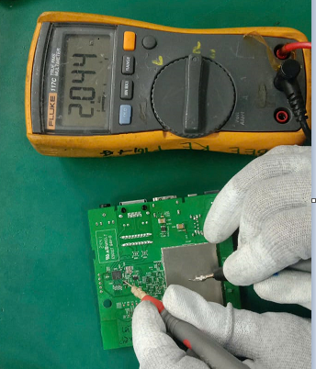
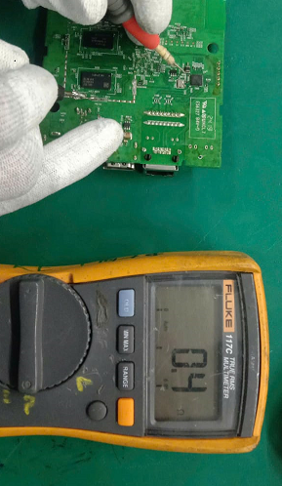
REG_OUT short analysis
Measurement 4 NG board power found out L801_REG_OUT short 0 ohm with GND.
L801_REG_OUT Checking | OK board | RMA boards
 |  | #9 | #23 | #24 | #26
Voltage Diode(V) | ~ 0.786 | 0.006 | 0.007 | 0.001 | 0.012
Impedance | 2.044k | 0.6 | 0.8 | 0.3 | 0.4
Separate components verify.
Schematic
OK
NG
U801_RTL8211F-CG
L801_REG_OUT
- Based on schematic, separate each components and recheck impedance on L801_REG_OUT path.
- Separate (U1 → U306 → U1101 → U801 locations) and check impedance → L801_REG_OUT No short 0 ohm with GND.
U801 location are abnormal for L801_REG_OUT short issue.
Summary :
➔ NG#9,#23,#24,#26 : This issue follow U801_RTL8211F-CG (MPM: RTL8211F-CG, P/N 002.02152.005, DC:DN52; 02/16/2024; O04; O08, Vendor: REALTEK) component

Slide 14
Measure U801_RTL8211F-CG analysis
Measure impedance: Remove NG U801 to measure impedance result as table below:
Impedance measure (Ohm)
No# | Pin | OK sample | #9 | #23 | #24 | #26
1 | MDIP0 | 1.586M | 0 | 2.829K | 1.432K | 1.452M
2 | MDIN0 | 1.584M | 0 | 2.7 | 1.469M | 1.451M
3 | AVDD10 | 18.28K | 0 | 17.14K | 17.45K | 17.79K
4 | MDIP1 | 1.583M | 0 | 1.367M | 1.447M | 1.499M
5 | MDIN1 | 1.583M | 0 | 1.366M | 1.448M | 1.499M
6 | MDIP2 | 1.670M | 2.632K | 1.439M | 1.502M | 1.515M
7 | MDIN2 | 1.670M | 20 | 1.439M | 1.502M | 1.515M
8 | AVDD10 | 18.26K | 77.6K | 17.09K | 17.32K | 17.76K
9 | MDIP3 | 1.679M | 25.4 | 1.438M | 22.3 | 3.318K
10 | MDIN3 | 1.678M | 0 | 1.436M | 0 | 161.4
11 | AVDD33 | 124.7K | 7.4 | 36.5 | 34.3 | 30.3
12 | PHYRSTB | 0 | 0 | 0 | 0 | 0
13 | MDC | 0 | 0 | 0 | 0 | 0
14 | MDIO | 0 | 0 | 0 | 0 | 0
15 | TXD3 | 2.595M | 2.524M | 2.484M | 2.495M | 2.567M
16 | TXD2 | 2.589M | 2.531M | 2.486M | 2.495M | 2.568M
17 | TXD1 | 2.590M | 2.537M | 2.488M | 2.523M | 2.573M
18 | TXD0 | 2.586M | 2.525M | 2.482M | 2.523M | 2.571M
19 | TXCLT | 2.594M | 2.528M | 2.485M | 2.584M | 2.572M
20 | TXC | 2.591M | 2.529M | 2.488M | 2.584M | 2.572M
Impedance measure (Ohm)
No# | Pin | OK sample | #9 | #23 | #24 | #26
21 | DVDD10 | 2.029K | 6.4 | 1.727K | 5.4 | 2.037K
22 | RXD3/PHYAD0 | 2.393M | 2.350M | 2.326M | 2.348M | 2.369M
23 | RXD2/PLLOFF | 2.395M | 2.371M | 2.314M | 2.345M | 2.384M
24 | RXD1/TXDLY | 2.404M | 2.359M | 2.334M | 2.366M | 2.389M
25 | RXD0/RXDLY | 2.409M | 2.361M | 2.323M | 2.364M | 2.395M
26 | RXCTL/PHYAD2 | 2.399M | 2.358M | 2.322M | 2.361M | 2.374M
27 | RXC/PHYAD1 | 2.392M | 2.360M | 2.324M | 2.361M | 2.381M
28 | DVDD_RG | 216.8K | 212.8K | 174.1K | 213.7K | 181.1K
29 | DVDD33 | 184.3K | 112.5K | 18.7 | 122.4K | 1.147K
30 | REG_OUT/LDO_OUT | 1.275M | 1.223M | 1.076M | 1.172M | 1.161M
31 | INTB/PMEB | 0 | 0 | 0 | 0 | 0
32 | LED0/CFG_EXT | 2.498M | 2.435M | 2.216M | 2.310M | 2.303M
33 | LED1/CFG_LDO0 | 2.498M | 0 | 2.212M | 2.310M | 2.303M
34 | LED2/CFG_LDO1 | 2.493M | 2.451M | 2.218M | 2.344M | 2.302M
35 | CLKOUT | 2.454M | 2.407M | 2.218M | 2.345M | 2.295M
36 | XTAL_IN | 2.515M | 2.357M | 2.217M | 2.362M | 2.379M
37 | XTAL_OUT/EXT_CLK | 2.908M | 2.737M | 2.667M | 2.367M | 2.754M
38 | AVDD10 | 83.1K | 1.556K | 1.233K | 45.3K | 79.6K
39 | RSET | 2.515M | 0 | 2.288M | 0 | 2.372M
40 | AVDD33 | 124.6K | 7.7 | 36.3 | 6.4 | 30.4
Summary: U801_RTL8211F-CG (MPM: RTL8211F-CG, P/N 002.02152.005, DC:DN52; O07; O04; O08, Vendor: REALTEK) have pins: MDIP0, MDIN0, AVDD10, MDIP1, MDIN1, AVDD33, DVDD10 impedance abnormal

Slide 15
Top 2: System block fail analysis.

Slide 16
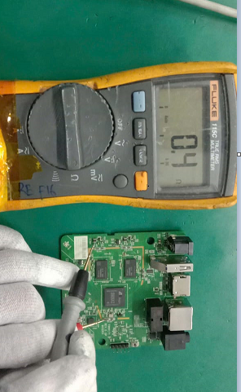
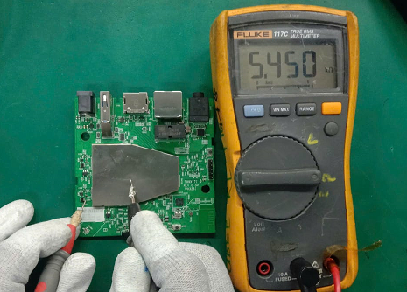
P3V3 short analysis
Measurement 6 NG board found out L304_P3V3 short 0 ohm with GND.
L304_P3V3 Checking | OK board | RMA boards
 |  | #4 | #7 | #8 | #10 | #19 | #20
Voltage Diode(V) | ~ 0.352 | 0.001 | 0.002 | 0.003 | 0.001 | 0.004 | 0.003
Impedance | >5.450k | 0.3 | 0.5 | 0.6 | 0.4 | 0.5 | 0.6
Separate components verify.
Schematic
NG
OK
L304_P3V3
U1_S905X2_B
P3V3
- Based on schematic, separate each components and recheck impedance on L304_P3V3 path.
- Separate (U801→ U1001→ U1101→ U601 → U1 Locations) and check impedance → L304_P3V3 No short with 0 ohm GND.
U1 location are abnormal for L304_P3V3 short issue.
Summary :
➔ NG#4,#7,#8,#10,#19,#20 : This issue follow U1_S905X2_B (MPM:S905X2-B, P/N: 002.02753.005, DC: 20240408, 20231224, 20231224, D20240122, D20240122, Vendor: AMLOGIC) component.

Slide 17
Measure U1_S905X2_B analysis
Measure impedance: Remove U1 and measure impedance result as table below:
NO# | Pin# | Description | OK Sample | #4 | #7 | #8 | #10 | #19 | #20
1 | J32 | AVDD18_PCIe | 225K | 245K | 230K | 228K | 224kK | 223K | 238K
2 | L29 | AVDD33_USB | 0.931M | 89.2K | 7.83 | 67.4k | 9.90 | 0.942M | 0.942M
3 | L31 | VDDIO_H | 38 | 9.1 | 8.9 | 3.2 | 9.0 | 10.6 | 9.8
4 | L33 | AVDD18_ENET | 1.525M | 1.495M | 1.62M | 1.495M | 1.455M | 1.468M | 1.448M
5 | L35 | AVDD18_USB | 1. 353M | 1. 353M | 1. 353M | 1. 353M | 1. 352M | 1. 3554M | 1. 353M
6 | G14 | VDDQ | 32.3K | 45.6K | 31.4K | 58.6K | 40.9K | 32.9K | 33.5K
7 | G29 | VDDIO_AO | 37.3K | 50.9 | 45.8 | 40.6 | 42.2 | 67.3 | 47.4
8 | N31 | AVDD18_AUDIO | 0.908M | 0.967M | 1.075M | 0.853M | 0.965M | 0.897M | 1.015M
9 | N33 | AVDD18_HDMI | 1.426M | 1.592M | 1.471M | 1.466M | 1.465M | 1.447M | 1.424M
10 | P13 | VDDQ | 10.11K | 11.25K | 11.12K | 267.8 | 11.3K | 145.6 | 11.23K
11 | P15 | VDDQ | 10.10K | 11.25K | 11.12K | 10.09K | 11.26K | 267.3 | 10.9K
12 | J14 | VDDQ | 10.26K | 11.28K | 11.85K | 9.88K | 11.58 | 9.56K | 10.23K
13 | J29 | VDDIO_C | 40.4 | 41.6 | 40.3 | 41.3 | 40.9 | 40.3 | 42.1
14 | R26 | AVDD0V8_USB_PCIe | 3.972K | 21.2 | 0.941K | 0.951K | 0.841K | 3.855K | 28.6
15 | R28 | AVDD0V8_HDM | 28.84K | 1.046K | 28.87K | 29.54K | 1.124K | 26.96K | 28.36K
16 | R31 | AVDD18_AO | 1.14M | 1.252M | 1.17M | 1.076M | 1.12M | 1.089M | 1.13M
17 | R33 | AVDD18_CVBS | 1.379M | 1.336M | 1.42M | 1.323M | 0.679M | 1.34M | 1.368M
18 | AA23 | AVDD18_AO | 1.167M | 0.781M | 1.158M | 1.065M | 1.089M | 1.135M | 1.164M
19 | AG20 | VDDCPU | 48.5 | 44.4 | 42.8 | 50.2 | 41.9 | 44.6 | 47.6
20 | AG26 | VDD_EE | 27.2 | 11 | 29 | 29.9 | 22.6 | 23.8 | 23.5
21 | U15 | VDDQ | 69K | 58.5K | 56k | 74.2K | 58k | 72.6K | 69.3K
22 | U17 | VDD_EE | 25 | 11.1 | 28 | 29.6 | 26.3 | 17 | 16.3
23 | AC15 | AVDD_DDRPLL | 0.656M | 0.785M | 0.703M | 0.696M | 0.759M | 0.632M | 0.756M
24 | AJ15 | VDDQ | 10.49K | 11.72K | 11.09K | 10.76K | 11.23K | 10.9K | 10.6K
NO# | Pin# | Description | OK Sample | #4 | #7 | #8 | #10 | #19 | #20
25 | U26 | VDD_EE | 31.5 | 11.2 | 34.7 | 34.9 | 33.6 | 32.1 | 32.3
39 | AJ20 | VDDCPU | 43.5 | 45.3 | 47.8 | 49.4 | 42.6 | 42.3 | 45.9
27 | AJ23 | VDDCPU | 43.5 | 45.3 | 47.6 | 49.5 | 46.2 | 42.6 | 43.3
28 | AJ26 | VDD_EE | 25.7 | 10.8 | 27.1 | 28.3 | 25.6 | 24.3 | 23.8
29 | AJ29 | VDD_EE | 26.2 | 23.6 | 28.4 | 28.9 | 26.3 | 27.5 | 27.6
30 | AJ31 | VDDAO_0V8 | 0.953K | 0.823M | 1.17K | 1.366K | 0.935K | 0.978K | 0.874K
31 | AJ39 | AVDD18_AO | 1.082M | 0.988M | 1.11M | 1.013M | 1.102M | 0.996M | 1.13M
32 | AE26 | VDD_EE | 26.7 | 27.6 | 29 | 29.2 | 26.5 | 25.5 | 28
33 | AL20 | VDDCPU | 44.7 | 45.1 | 47.9 | 50.3 | 44.3 | 45.2 | 44.1
34 | AL23 | VDDCPU | 44.8 | 45 | 48 | 50.2 | 42.6 | 49.8 | 46.9
35 | Y15 | VDDQ | 70.4K | 54.8K | 72.1K | 55.5K | 53.6K | 77.6K | 72.9K
36 | AF15 | VDDQ | 69.4K | 54.2K | 70.6K | 54.4K | 54.1K | 66.3K | 66.7K
37 | AF17 | VDD_EE | 25.9 | 23.6 | 27.7 | 28.4 | 26.5 | 22.9 | 24.8
38 | AF29 | VDD_EE | 25.8 | 23.6 | 27.7 | 28.4 | 25.9 | 23.4 | 22.1
39 | AF31 | VDD_EE | 25.8 | 22.4 | 27.5 | 28.3 | 24.9 | 25.6 | 27.5
40 | AM31 | VDD_EE | 40.7 | 26.8 | 44.6 | 37.8 | 38.3 | 38.7 | 35.4
41 | AU26 | VDDCPU | 44.7 | 48.6 | 49.4 | 50.3 | 44.6 | 46.6 | 48.7
42 | AV37 | VDDIO_X | 2.54M | 2.63M | 2.51M | 2.668M | 2.661M | 2.364M | 2.574M
43 | AV39 | VDDIO_Z | 3.47M | 3.41M | 3.45M | 3.520M | 3.42M | 3.363M | 3.421M
44 | AN23 | VDDCPU | 3.16M | 2.8M | 3.17M | 3.09M | 2.82M | 3.36M | 2.45M
45 | AW20 | VDDIO_BOOT | 3.03M | 3.54M | 3.18M | 3.108M | 3.52M | 3.121M | 3.13M
46 | AW26 | VDDCPU | 58.2 | 54.8 | 61 | 64.8 | 57.3 | 54.1 | 55.2
47 | AR26 | VDDCPU | 53.4 | 55.8 | 60.8 | 64.9 | 55.3 | 56.1 | 52.4
Summary: U1_S905X2_B (MPM:S905X2-B, P/N: 002.02753.005, DC: 20240408, 20231224, 20231224, D20240122, D20240122, Vendor: AMLOGIC) have pins: AVDD33_USB, VDDIO_H, VDDIO_AO, AVDD0V8_USB_PCIe impedance abnormal

Slide 18
Top 3: No boot analysis.

Slide 19
No boot analysis
Baking(45°C in 24 hour)→ Check boot up and measurement 5pcs no boot up
MAC | FA
#22: 2C9811A62306 | - Inspection check →No found out abnormal - The product status boot up fail( don’t have HDMI out put, no ping) - Measure power supply U303, U304, U301, U302, U308,U306→ Power supply No Abnormal. - Take NG board BAKING (45°C in 24 hour). - After Baking → Re-test at FATP (UK→FT→FT1→RC→BURN IN 8 MINUTES →RC 1→ OBA→RC2)→ Normal Pass Root cause: - Suspect the units were moisture-contaminated.
#5: 2C9811A7885E
#1: 2C9811A619C2
#2: 2C9811A67F85
#16: 2C9811A548CE
Summary:
- Suspect product not well preserved

Slide 20
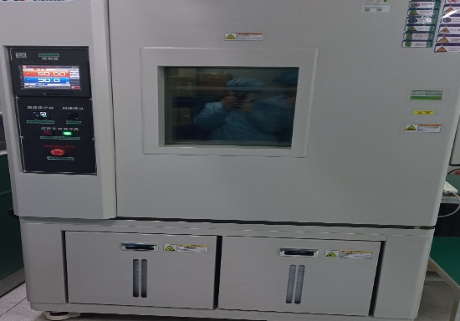
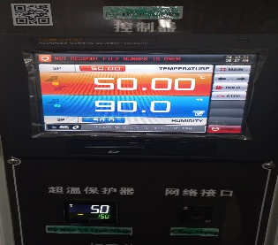





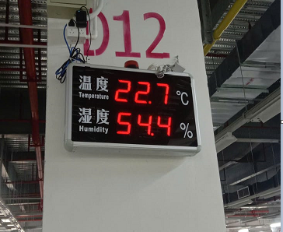





Temperature & humidity experiment - 1
Operate the units for 24 hours at 50°C and 90% humidity.
After 24 hours, re-test at OBA → PASS
#No. | #1 | #2 | #5 | #16 | #22 | Result
Log |  |  |  |  |  | Pass normal
Set 50°C and 90% humidity.
Store at room temperature for another 24 hours (22.7°C and 54.4% humidity)
After 24 hours, re-test at OBA → PASS
#No. | #1 | #2 | #5 | #16 | #22 | Result
Log |  |  |  |  |  | Pass normal
Set 22.7°C and 54.4% humidity.
Summary:
- Operate the units for 24 hours at 50°C and 90% humidity and store at room temperature for another 24 hours.→ Can’t reproduce the symptoms

Slide 21
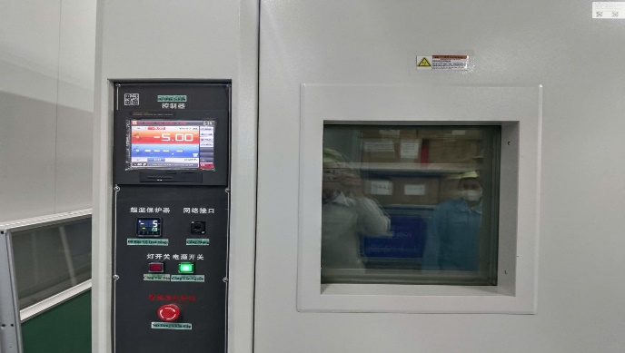
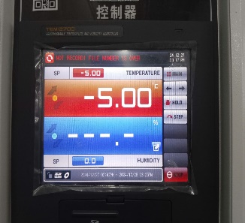





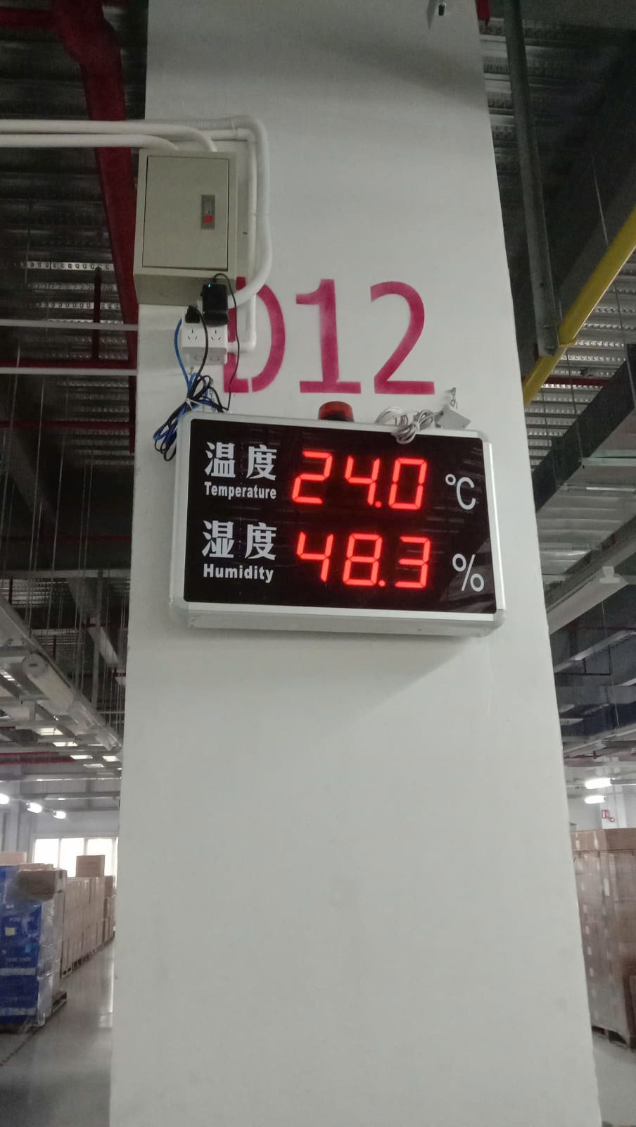
Temperature & humidity experiment - 2
Operate the units for 24 hours at -5°C and 0% humidity.
After 24 hours, re-test at OBA → 4pcs PASS, 1pc Fail
#No. | #1 | #2 | #5 | #16 | #22 | Result
Log |  |  |  |  |  | 4 pcs Pass normal, 1pc Fail
Fail
Set -5°C and 0% humidity.
Store at room temperature for another 24 hours (24°C and 48.3% humidity)
After 24 hours, re-test at OBA → PASS
#No. | #1 | #2 | #5 | #16 | #22 | Result
Log |  |  |  |  |  | 4 pcs Pass normal, 1pc Fail
Fail
Set 24°C and 48.3% humidity.
Summary:
- Operate the units for 24 hours at -5°C and 0% humidity and store at room temperature for another 24 hours→ 1 pc fail (#22: 2C9811A62306 No boot)

Slide 22
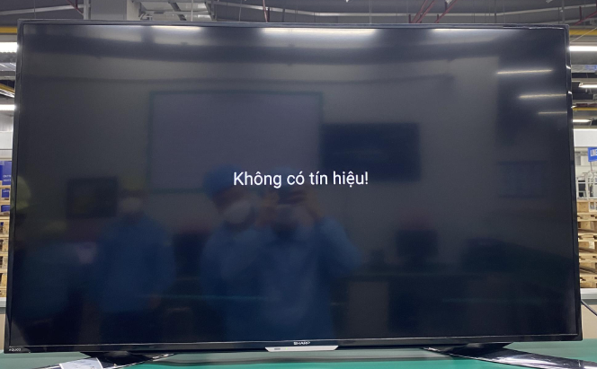
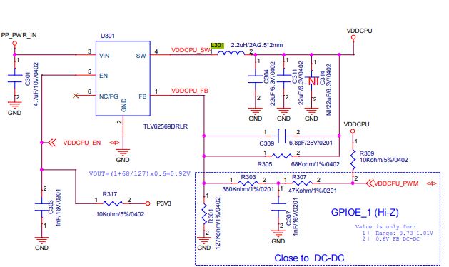
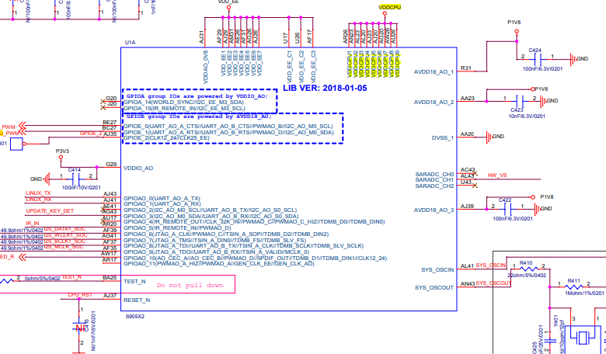
#22-2C9811A62306: Can’t boot up analysis-1
VI product ➔ No found abnormal
Power on ➔ Product can’t BOOT UP
Boot up fail
Measure Impedance & Voltage: Power on and measure
NO# | Pin# | Description | OK Sample |  | #22
 |  |  | Voltage | Impedance | Voltage | Impedance
1 | C305 | VDD_EE | 4.965 | 3.603K | 5.075 | 3.513K
2 | C312 | VDD_EE | 4.931 | 3.617K | 5.075 | 3.504K
3 | R328 | PP_PWR_IN | 4.861 | 232.1K | 4.94 | 235.5K
4 | L303 | P1V2 | 1.208 | 135 | 1.197 | 147.8
5 | L304 | P3V3 | 3.325 | 2.829K | 3.257 | 2.814K
6 | C322 | eMMC_VDDQ | 1.798 | 24.71K | 1.795 | 24.06K
7 | L301 | VDDCPU | 1.012 | 70.3 | 0.799 | 40.6
8 | L302 | VDD_EE | 0.838 | 39.1 | 0.841 | 40.7
9 | C1409 | HDMI_PW | 5.016 | 1.142M | 5.106 | 1253M
10 | C908 | USB_5V | 5.084 | 0.886M | 5.103 | 0.996M
11 | L801 | ETH_DVDD10 | 1.008 | 1.752K | 1.005 | 1.776K
12 | C311 | VDDCPU | 1.009 | 79.5 | 0.796 | 43.7
13 | C335 | P3V3 | 3.324 | 2.856K | 3.257 | 2.804K
SUMMARY: Measure impedence & voltage have pin: VDDCPU abnormal➔ This issue follow U1_S905X2_B (MPM:S905X2-B, P/N: 002.02753.005, DC: 20240325: , Vendor: AMLOGIC)➔Need baking production (45°C in 24 hour).

Slide 23

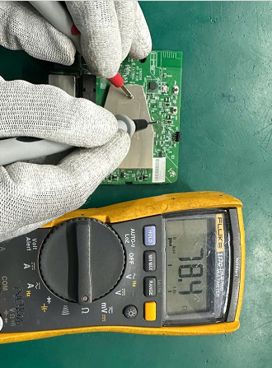
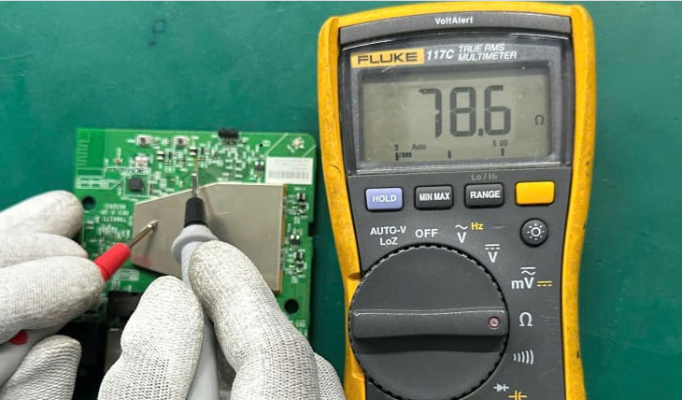
#22-2C9811A62306: Can’t boot up analysis-2
After BAKING 45°C/24h as table below:
Items | Test condition | Time | OBA Test
BAKING | 45°C/24h | From 2025/01/03 16:30 To 2025/01/04 16:30
NO# | Pin# | Description | OK Sample |  | #22
 |  |  | Voltage | Impedance | Voltage | Impedance
1 | C305 | VDD_EE | 4.965 | 3.603K | 5.056 | 3.545K
2 | C312 | VDD_EE | 4.931 | 3.617K | 5.054 | 3.536K
3 | R328 | PP_PWR_IN | 4.861 | 232.1K | 4.884 | 236.5K
4 | L303 | P1V2 | 1.208 | 135 | 1.211 | 146.5
5 | L304 | P3V3 | 3.325 | 2.829K | 3.236 | 2.811K
6 | C322 | eMMC_VDDQ | 1.798 | 24.71K | 1.798 | 24.12K
7 | L301 | VDDCPU | 1.012 | 79.3 | 1.009 | 78.6
8 | L302 | VDD_EE | 0.838 | 39.1 | 0.844 | 40.9
9 | C1409 | HDMI_PW | 5.016 | 1.142M | 5.036 | 1.256M
10 | C908 | USB_5V | 5.084 | 0.886M | 5.098 | 0.985M
11 | L801 | ETH_DVDD10 | 1.008 | 1.752K | 1.006 | 1.775K
12 | C311 | VDDCPU | 1.009 | 79.5 | 1.009 | 78.4
13 | C335 | P3V3 | 3.324 | 2.856K | 3.259 | 2.812K
PASS
L301
C311
Summary:
After burning 45°C/24h, measure impedance of L301-VDDCPU & C311-VDDCPU is normally
➔ Suspect U1_S905X2_B MSD issue (Moisture sensitive device)

Slide 24
#22-2C9811A62306: test ORT and measure
After test ORT Thermal shock (15 cycle: -20°C in 30 min to 70°C in 30 min) and measure U301 power block as below table:
NO# | Pin# | Description | OK Sample |  | Before ORT |  | After ORT
 |  |  | Voltage | Impedance | Voltage | Impedance | Voltage | Impedance
1 | U301 | VIN | 5.041 | 2.361M | 5.043 | 2.365M | 5.043 | 2.365M
 |  | EN | 3.253 | 41.36K | 3.255 | 41.38K | 3.255 | 41.38K
 |  | SW | 1.004 | 55 | 1.007 | 55.2 | 1.007 | 55.2
 |  | FB | 0.746 | 32.45K | 0.745 | 32.47K | 0.753 | 32.47K
 |  | GND | 0 | 1.2 | 0 | 1.1 | 0 | 1.1
 |  | GC/PN | 3.582 | 13.16M | 3.584 | 13.18M | 3.584 | 13.18M
2 | L301 | VDDCPU_SW | 1.003 | 79.2 | 1.005 | 79.4 | 1.007 | 79.1
3 | C301 | PP_PWR_IN | 5.044 | 3.451K | 5.043 | 3.435K | 5.043 | 3.449K
4 | C309 | VDDCPU_FB | 0.746 | 32.89K | 0.745 | 32.86K | 0.753 | 32.88K
5 | R305 | VDDCPU_FB | 0.756 | 32.83K | 0.745 | 32.94K | 0.755 | 32.99K
6 | R303 | VDDCPU_FB | 0.745 | 33.05K | 0.746 | 33.08K | 0.753 | 33.04K
8 | R301 | VDDCPU_FB | 0.745 | 33.09K | 0.744 | 33.03K | 0.749 | 33.06K
10 | R317 | VDDCPU_EN | 3.259 | 2.751K | 3.261 | 2.746K | 3.257 | 2.744K
11 | C303 | VDDCPU_EN | 3.254 | 28.38K | 3.256 | 28.39K | 3.255 | 28.35K
Summary:
- Then test ORT→ Voltage and impedance no abnormal→ U301 power block not effected by moisture-contaminated.
- The factory environment always kept at tem: 19-27°C & Humidity: 31-59%R.H to preserve material→ Moisture-contaminated. CAN NOT HAPPEN at the factory.

Slide 25
Top 4: eMMC block fail analysis.

Slide 26
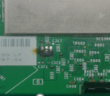
U303 burned analysis
Check VI 25 Boards find out 1pcs was burnt at eMMC block, result as table below:
U303
Serial Number | MAC | SN | Location | FA | Sample Picture
2149688001202404082178 | 2C9811A571C3 | YZR0XSO | U303 | - Fii sorting --> Boot up fail, don't have HDMI signal output, no Ping - After open housing --> Visual inspection find out U303 was burnt and burnt wire. => Can't further analyze and repair.
Summary :
- With product was burned→ Can’t FA and repair→ Suspect scrap

Slide 27
Summary
Summary:
Ethernet block fail -- U801_RTL8211F-CG was burnt
-- R825,R826 was burnt
-- REG_OUT short 0 ohm follow U801_RTL8211F-CG (MPM: RTL8211F-CG, P/N
002.02152.005, DC:DN52; O07; O04; O08, Vendor: REALTEK) material issue
System block fail -- P3V3 short 0 ohm follow U1_S905X2_B (MPM:S905X2-B, P/N: 002.02753.005, DC: 20240408, 20231224, 20231224, D20240122, D20240122, Vendor: AMLOGIC) material issue
No boot -- Suspect the units were moisture-contaminated
eMMC block fail -- U303 was burt→ Suspect scrap
All issue above can cover 100% at FATP
Suspect scrap

Slide 28


Action
Action:
Ethernet block fail – NG #3,#12,#15,#18,#25: U801_RTL8211F-CG was burnt
-- NG #11,#14,#21: R825,R826 was burnt
-- NG #9,23,24,26 REG_OUT short 0 ohm follow U801_RTL8211F-CG. Vender had
FA for this component→ suspect ESD SQE can co-work with vendor
AMLOGIC analysis material fail. Owner: SQE.Gavin
System block fail -- NG #4,7,8,10,19,20 P3V3 short 0 ohm follow U1_S905X2_B. Vender had FA for this component→ suspect ESD SQE can co-work with vendor AMLOGIC analysis material fail. Owner: SQE.Gavin
Keep track factory environment (Tem: 19-27°C & Humidity: 31-59%R.H) to preserve material.
eMMC block fail – NG #17: U303 was burt→ Suspect scrap
Suspect scrap

